Slide 1

Copyright © 2016 Pearson Education, Inc.

Slide 2

Section 3: Launching the Business
12
Managing Cash
Flow
12-2

Slide 3
Learning Objectives
Explain the importance of cash management to a small company’s success.
Differentiate between cash and profits.
Understand the five steps in creating a cash budget.
Describe fundamental principles involved in managing the “big three” of cash management: accounts receivable, accounts payable, and inventory.
Explain the techniques for avoiding a cash crunch in a small company.

Slide 4
The Importance of Cash
“Everything is about cash – raising it, conserving it, collecting it.” ~ Guy Kawasaki
Common cause of business failure: Cash crisis!
It is possible for a business to earn a profit and still go out of business by running out of cash.
Valley of death

Slide 5
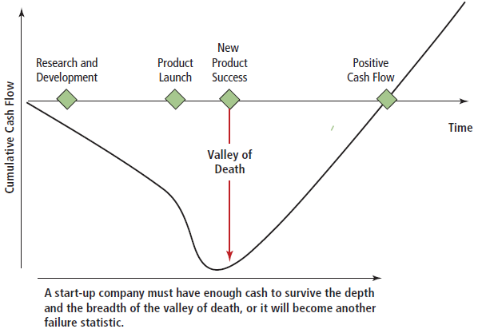
The Valley of Death

Slide 6
Cash Management
American Express OPEN Small Business Monitor study:
52% of small business owners experience problems with cash flow.
Their biggest cash flow concern is the ability to pay bills on time.

Slide 7
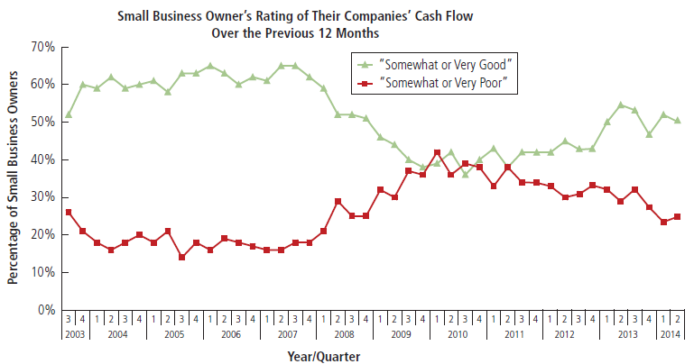
Small Business Owner’s Rating of Their Companies’ Cash Flow

Slide 8
Cash Management
Cash management:
The process of forecasting, collecting, disbursing, investing, and planning for the cash a company needs to operate smoothly.
Young and growing companies are “cash sponges.”
Know your company’s cash flow cycle.

Slide 9
Cash and Profits
Cash ≠ profits.
Profit is the difference between a company’s total revenue and total expenses.
Cash is the money that is free and readily available to use.
Cash flow measures a company’s liquidity and its ability to pay it bills.

Slide 10
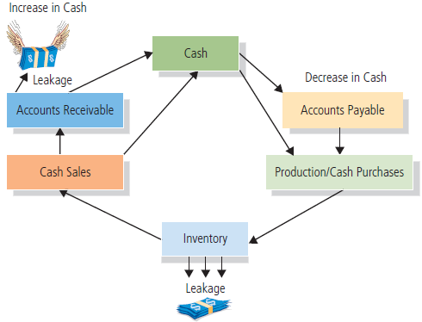
Cash Flow

Slide 11
The Cash Budget
Cash budget:
A “cash map” that shows the amount and the timing of a firm's cash receipts and cash disbursements over time.
Predicts the amount of cash a company will need to operate smoothly.
Helps to visualize a company’s cash receipts and cash disbursements and the resulting cash balance.

Slide 12
Preparing a Cash Budget
Five steps:
Determining an adequate minimum balance.
Forecasting sales.
Forecasting cash receipts.
Forecasting cash disbursements.
Estimating the end-of-the-month cash balance.

Slide 13
Determine an Adequate Minimum Cash Balance
Step 1:
The most reliable method of deciding the right minimum cash balance is based on past experience.

Slide 14
Forecast Sales
Step 2:
The heart of the cash budget.
Sales are ultimately transformed into cash receipts and cash disbursements.
Cash forecast is only as accurate as the sales forecast from which it is derived.

Slide 15
Forecast Sales
(continued)
“Lumpy” or seasonal sales patterns are common.
15% to 18% of wine and spirits shops’ annual sales occur between December 15 and 31.
40% of toy sales take place in last 6 weeks of the year.
Prepare three sales forecasts:
Pessimistic
Optimistic
Most Likely

Slide 16
Sales Forecast for a Start-Up
Example:
Number of cars in trading zone 84,000
x Percent of imports x 24%
= Number of imported cars in trading zone 20,160
Number of imports in trading zone 20,160
x Average expenditure on repairs x $485
= Total import repair sales potential $9,777,600
Total import repair sales potential $9,777,600
x Estimated market share x 9.9%
= Sales estimate $967,982

Slide 17
Forecast Cash Receipts
Step 3:
Record all cash receipts when the cash is actually received (i.e. the cash method of accounting).
Determine the collection pattern for credit sales; then add cash sales.
Monitor closely: Slow and non-payers.

Slide 18
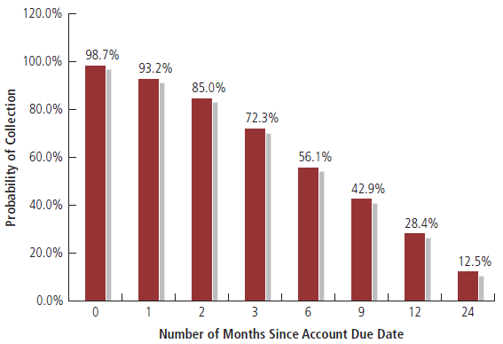
Probability of Collecting Accounts Receivable

Slide 19
Forecast Cash Disbursements
Step 4:
Record disbursements when you expect to make them.
Start with those disbursements that are fixed amounts due on certain dates.
Review the business checkbook to ensure accurate estimates.
Add a cushion to the estimate to account for “Murphy’s Law.”
Don’t know where to begin? Try making a daily list of the items that generate cash and those that consume it.

Slide 20
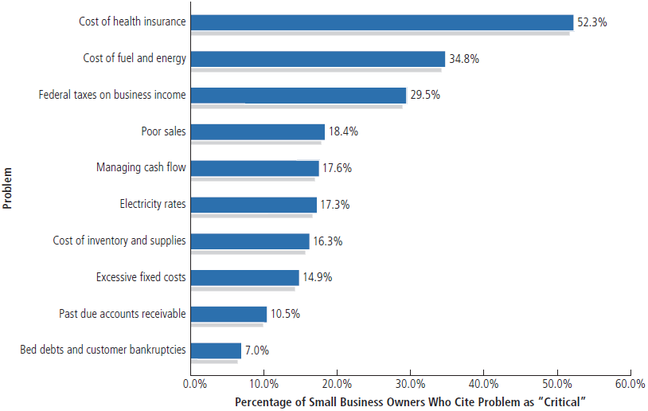
Cash Flow Concerns among Small Business Owners

Slide 21
Estimate End-of-Month Balance
Step 5:
Take Beginning Cash Balance ...
Add Cash Receipts ...
Subtract Cash Disbursements
Result Is Cash Surplus or Cash Shortage (Repay or Borrow?)

Slide 22
Benefits of Cash Management
Increase amount and speed of cash flowing into the company
Reduce the amount and speed of cash flowing out
Make the most efficient use of available cash
Take advantage of money-saving opportunities such as cash discounts

Slide 23
Benefits of Cash Management
(continued)
Finance seasonal business needs
Develop a sound borrowing and repayment program
Impress lenders and investors
Provide funds for expansion
Plan for investing surplus cash

Slide 24
The “Big Three” of Cash Management
Big Three:
Accounts receivable
Accounts payable
Inventory
The Big 3 interact to create a company’s cash conversion cycle:
The length of time required to convert inventory and accounts payable into sales and accounts receivable and finally back into cash.

Slide 25
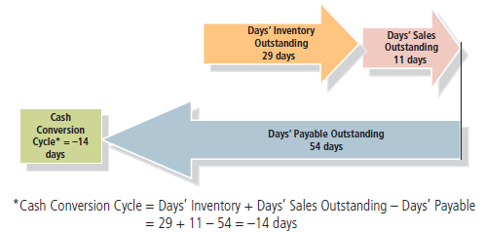
Amazon’s Cash Conversion Cycle

Slide 26
Accounts Receivable
About 90% of industrial and wholesale sales are on credit, and 40% of retail sales are on account.
Survey of small companies: 74% have accounts receivable outstanding for 60 or more days.
Remember: “A sale is not a sale until you collect the money.”
Accounts receivable goal: Collect your company’s cash as fast as you can.

Slide 27
Establish a Credit and Collection Policy
Screen credit customers carefully.
Establish a firm credit-granting policy.
Send invoices promptly.
Cycle billing
When an account becomes overdue, take action immediately.

Slide 28
Accelerating Accounts Receivable
Ensure that invoices are accurate and timely.
Include a description of the goods or services purchased.
Ensure that invoices match purchase orders or contracts.
Highlight the balance dues and due date.
Include contact information in case customers have questions.
Use a security agreement.

Slide 29
Accounts Payable
Stretch out payment times as long as possible without damaging your credit rating.
Verify all invoices before paying them.
Negotiate the best possible terms with your suppliers.
Be honest with creditors; avoid the “the check is in the mail” syndrome.
Schedule controllable cash disbursements to come due at different times.

Slide 30
Inventory
Monitor inventory closely; it can drain a company’s cash.
Avoid inventory “overbuying.”
It ties up valuable cash at a zero rate of return.
Arrange for inventory deliveries at the latest possible date.
Take advantage of discounts:
Quantity discounts
Cash discounts

Slide 31
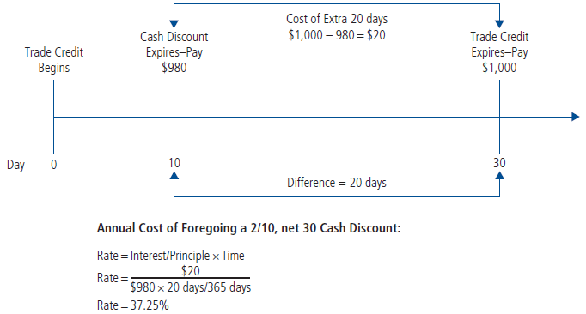
A Cash Discount

Slide 32
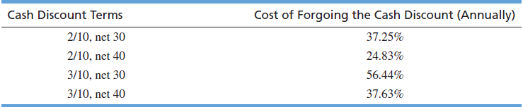
Cost of Forgoing Cash Discounts

Slide 33
Avoiding the Cash Crunch
Barter
Consider bartering, exchanging goods and services for other goods and services, to conserve cash.
More than 500 barter exchanges operate across the United States.

Slide 34
Avoiding the Cash Crunch
(continued)
Trim overhead costs:
Ask for discounts and “freebies”
Conduct periodic expense audits
Lease rather than buy
Operating lease
Capital lease
Avoid nonessential cash outlays
Buy used or reconditioned equipment
Hire part-time employees and freelancers

Slide 35
Avoiding the Cash Crunch
(continued)
Outsource
Use e-mail rather than mail
Use credit cards for small purchases
Negotiate fixed loan payments to coincide with your company’s cash flow
Establish an internal security and control system
Develop a system to battle check fraud
Change shipping terms

Slide 36
Avoiding the Cash Crunch
(continued)
Start selling gift cards
Switch to zero-based budgeting
Be on the lookout for employee theft
Keep your business plan current
Build a cash cushion
Invest surplus cash
Money market account
Zero-balance account

Slide 37
Conclusion
“Cash is King”
Cash and profits are not the same.
Entrepreneurial success means operating a company “lean and mean.”
Trim wasteful expenditures.
Invest surplus funds.
Plan and manage cash flow.

Slide 38
